Slide 1



Java Bootcamp Spring MVC Framework
Ver. 0.1

Slide 2
Spring Framework
1
Introduction
Environment
HTML and Css Layout

Slide 3
Goal
Participants are able to understand Spring well, so participants can benefit from the spring framework itself, including:
FullStack Web Developer
Database Design
Solution Skeleton
MVC Web Application
Web Method: Get & Post
UI Bootstrap Framework
Jquery & AJAX

Slide 4
Environment
IDE / Editor
Spring Tool Suit (STS) Latest Version.
DBMS / Database Server
Postgresql 9.x
Operating System
Ubuntu 18.04
Framework
Spring Boot 2.1.x
ORM
Spring Data
UI
Bootstrap, Adminlte

Slide 5
Spring Framework
This spring was created by Rod Johnson which aims to overcome system design problems in enterprise application development.
Spring also implements several IoC (Inversion of Control) technologies into an MVC (Model-View-Controler)
Intended for applications that require high performance, are easy to test, and can be reused.

Slide 6
Benefits of Spring Framework
Spring helps developers develop enterprise-class applications.
Spring does not recreate, but actually utilizes some existing technologies such as some ORM frameworks, logging frameworks, and other technologies.
Application testing in Spring is done simply.
Web Framework Spring is a well-designed web MVC Framework.

Slide 7
Spring Modul
Spring framework consists of many modules such as IOC, AOP, DAO, Context, ORM, MVC WEB, Context, Expression Language, JDBC, ORM, Transactions, JMS, WEB, Servlet and many more.

Slide 8
HTML
HTML is the standard markup language for creating Web pages.
HTML stands for Hyper Text Markup Language
HTML describes the structure of Web pages using markup
HTML elements are the building blocks of HTML pages
HTML elements are represented by tags
HTML tags label pieces of content such as "heading", "paragraph", "table", and so on
Browsers do not display the HTML tags, but use them to render the content of the page

Slide 9
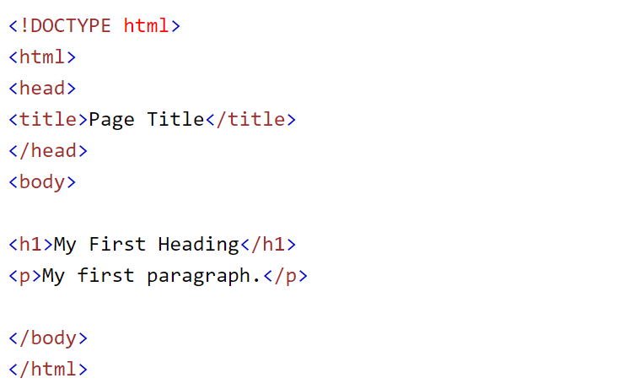
HTML Code

Slide 10
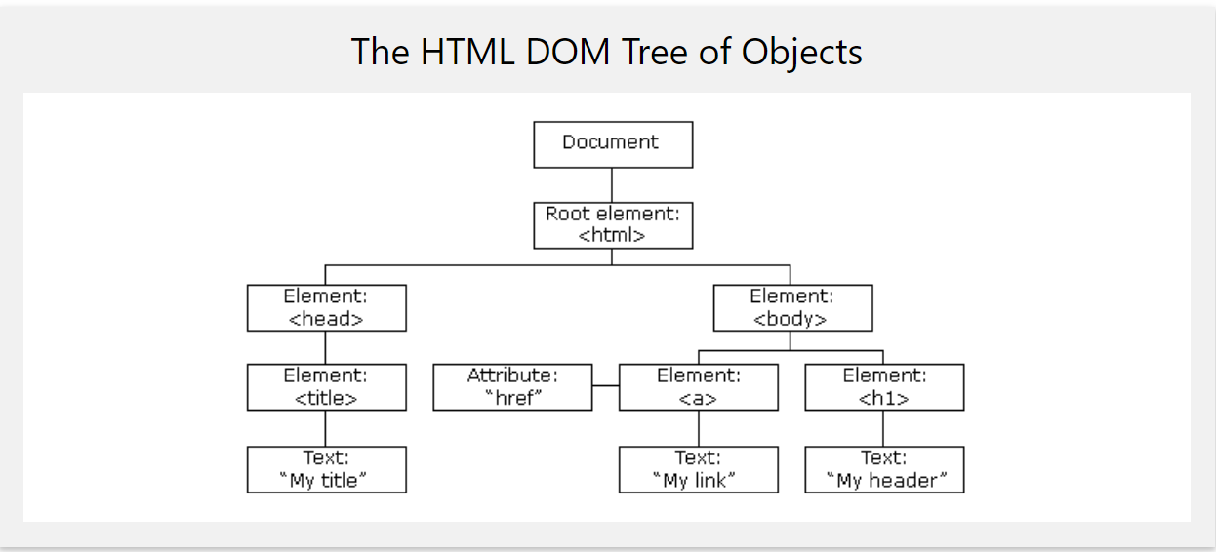
DOM HTML (Document Object Model)
When a web page is loaded, the browser creates a Document Object Model of the page.

Slide 11
CSS (cascading style sheets)
CSS is used to control the style of a web document in a simple and easy way.
CSS handles the look and feel part of a web page.
Control the color of the text, the style of fonts and Desain UX of HTML page.
Manage display for different devices and screen sizes as well as a variety of other effects.

Slide 12
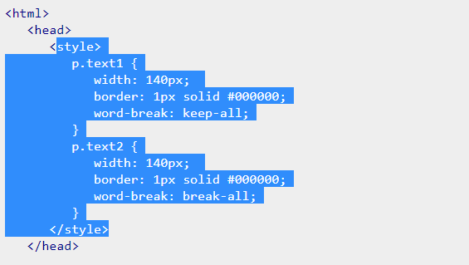
Sample CSS Code

Slide 13
Task
1. please open http://www.xsis.co.id/
2. From what has been learned html and css, please create it according to the site with your own design.

Slide 14
Spring Framework
Day 2 & 3
Hello World
Spring Starter
Spring MVC
Maven

Slide 15
Hello Java Web
Create Web Project with Spring boot
Spring MVC
Compilation Code

Slide 16
Prequitest Spring Boot
Java 1.8
Gradle 2.3+ or Maven 3.0+
Spring Framework 5.0.0.BUILD-SNAPSHOT
An IDE (Spring Tool Suit) Version: 4.0

Slide 17
Spring Starter
Spring Maven Project
Spring Project Wizard
Spring Initializr

Slide 18
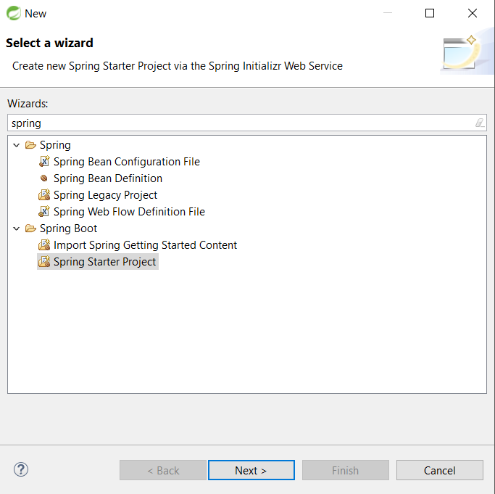
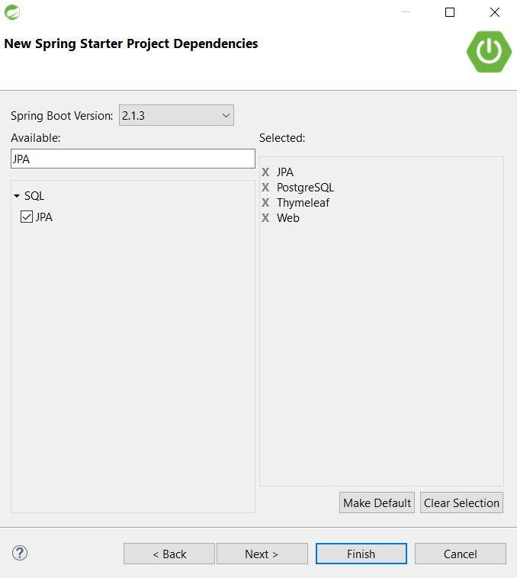
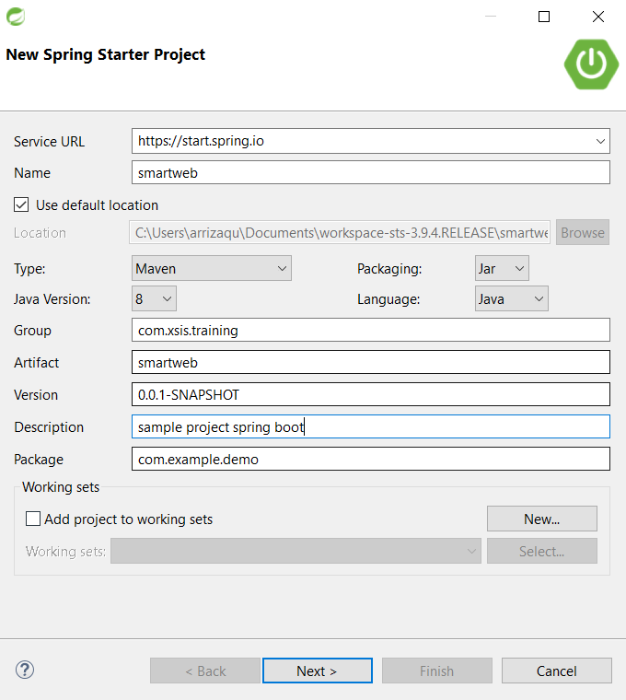
Create New Project With Spring Boot

Slide 19
Spring MVC
Model commonly used to present the form of data and application data. Model Object is used to receive and store in a database.
View is a User Interface to display data models, and can also be used to change data.
The controller will be responsible for handling user requests, where with this the user will always communicate with the application via the controller.

Slide 20
Hello As Controller
Create Controller Package
Create Hello Class as Controller

Slide 21
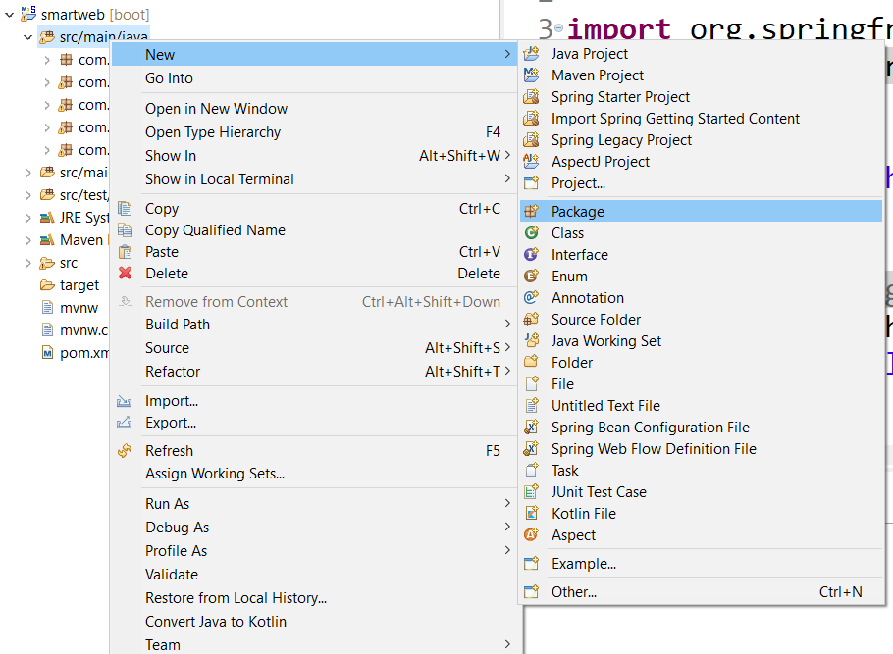
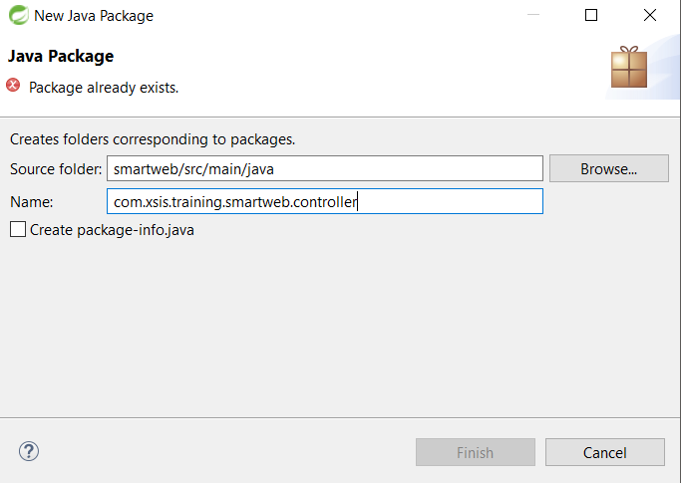
Create Controller Package

Slide 22
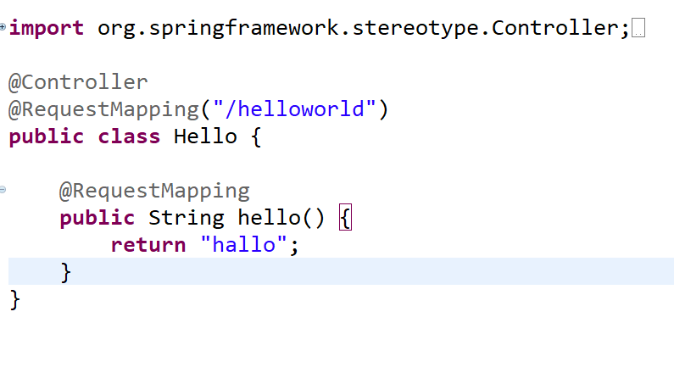
Create Hello Class as Controller

Slide 23
JSP as View
Setup View POM Dependency
Create JSP View Directory
Configure application.properties

Slide 24
Build Application with Maven
Maven’s primary goal is to allow a developer to comprehend the complete state of a development effort in the shortest period of time.
Making the build process easy
Providing a uniform build system
Providing quality project information
Providing guidelines for best practices development
Allowing transparent migration to new features

Slide 25
View
View is useful for handling as a user interface of a request.
Many libraries to support View in java, including: JSTL, Thymleaf, Tiles and sitemesh.

Slide 26
Thymeleaf
Ideal for modern-day HTML5 JVM web development
modern server-side Java template engine for both web and standalone environments.
Thymeleaf still look and work like HTML.

Slide 27
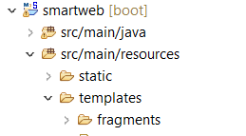
Thymeleaf Directory
Add Thymleaf directory “src -> main -> resources -> templates”

Slide 28
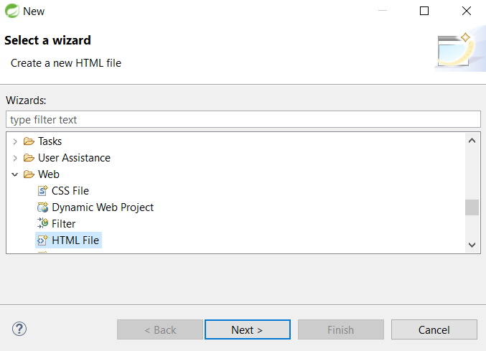
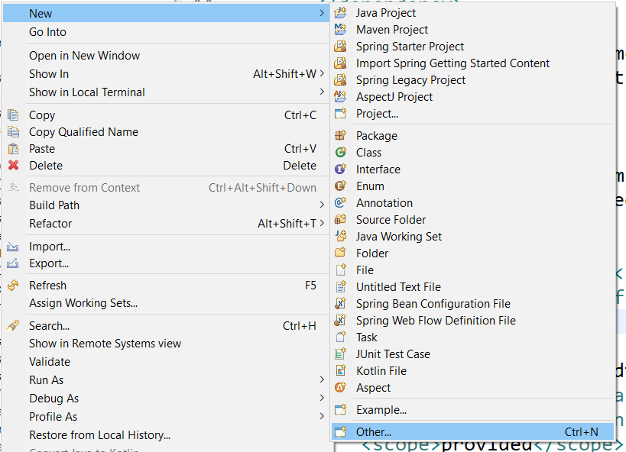
Create HTML File
Right Click on template directory and Open Wizard to Create new HTML File

Slide 29
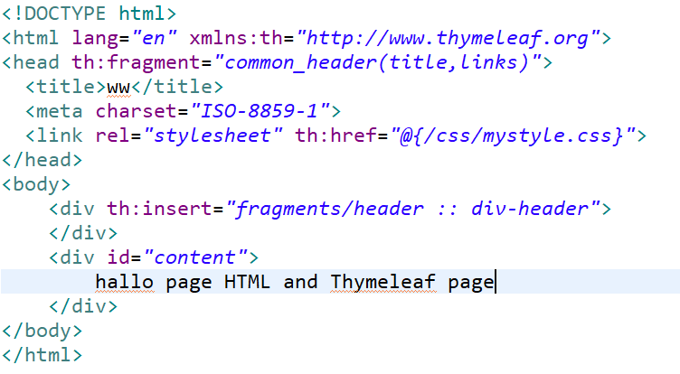
HTML Code

Slide 30
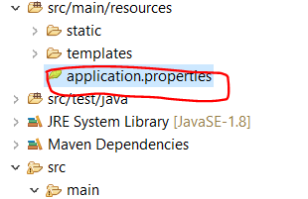
Configure application.properties
Open and add script configuration in application.properties

Slide 31
Application Properties
File properties are used to store ‘N’ the number of properties in one file to run applications in different environments.
Spring Boot provides various properties that can be specified in the project "application.properties" file.
This property has a default value and you can set it in the property file, such as: PORT number and Database Configuration.

Slide 32
} | Default value | Description
banner.charset | UTF-8 | It is used to set banner file encoding.
banner.location | classpath:banner.txt | It is used to set banner file location.
logging.file |  | It is used to set log file name. For example data.log.
spring.application.index |  | It is used to set application index.
spring.application.name |  | It is used to set application name.
spring.application.admin.enabled | false | It is used to enable admin features for the application.
spring.config.location |  | It is used to config file locations.
spring.config.name | application | It is used to set config file name.
spring.mail.default-encoding | UTF-8 | It is used to set default MimeMessage encoding.
spring.mail.host |  | It is used to set SMTP server host. For example smtp.example.com.
spring.mail.password |  | It is used to set login password of the SMTP server.
spring.mail.port |  | It is used to set SMTP server port.
spring.mail.test-connection | false | It is used to test that the mail server is available on startup.
spring.mail.username |  | It is used to set login user of the SMTP server.
spring.main.sources |  | It is used to set sources for the application.
server.address |  | It is used to set network address to which the server should bind to.
server.connection-timeout |  | It is used to set time in milliseconds that connectors will wait for another HTTP request before closing the connection.
server.context-path |  | It is used to set context path of the application.
server.port | 8080 | It is used to set HTTP port.
server.server-header |  | It is used for the Server response header (no header is sent if empty)
server.servlet-path | / | It is used to set path of the main dispatcher servlet
server.ssl.enabled |  | It is used to enable SSL support.
spring.http.multipart.enabled | True | It is used to enable support of multi-part uploads.
spring.http.multipart.max-file-size | 1MB | It is used to set max file size.
spring.mvc.async.request-timeout |  | It is used to set time in milliseconds.
spring.mvc.date-format |  | It is used to set date format. For example dd/MM/yyyy.
spring.mvc.locale |  | It is used to set locale for the application.
spring.social.facebook.app-id |  | It is used to set application's Facebook App ID.
spring.social.linkedin.app-id |  | It is used to set application's LinkedIn App ID.
spring.social.twitter.app-id |  | It is used to set application's Twitter App ID.
security.basic.authorize-mode | role | It is used to set security authorize mode to apply.
security.basic.enabled | true | It is used to enable basic authentication.

Slide 33
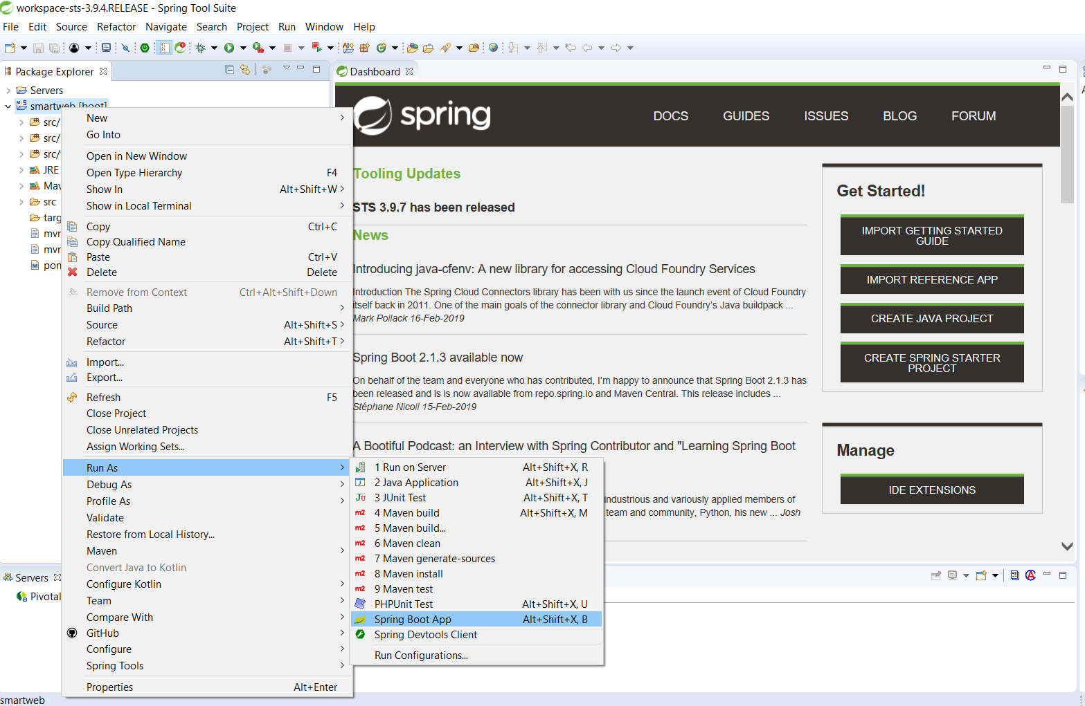
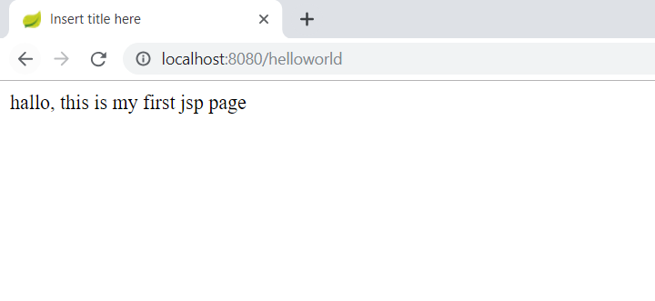
RUN Application
Type in your browser

Slide 34
Spring Boot
Spring Boot makes us to accelerate and provide standard facilities when developing applications
Predefined Templates, where spring has provided templates for several processes including: JDBC, Hibernate and JPA, which doesn't require much code for that.
Loose Couple, that is, with the presence of DI (Dependency Injection) it will eliminate dependency on other libraries.
Providing ‘starters’ library easily to make standard configurations
Does not require XML configuration
It is the starting point for building spring-based applications, and is designed to make initial configuration as fast as possible.
Easy to do a test, for example: JUNIT.

Slide 35
Dependency Management
Spring Boot automatically manages dependencies and configurations. so there is no need to specify the version for all the dependencies in the spring boot.

Slide 36
Spring Annotation
Starting from Spring 2.5 it becomes possible to configure Dependency Injection using "Annotation“.
1. @Autowired 7. @RequestBody
2. @Controller 8. @ResponseBody
3. @Component 9. @ResponseStatus
4. @Service 10. @ModelAttribute
5. @Repository 11. @RequestParam
6. @RequestMapping 12. @Transactional

Slide 37
Spring Framework
Day 4 & 5
Working with Database
ORM and Spring Data Jpa
Knowing Service
Knowing Repository

Slide 38
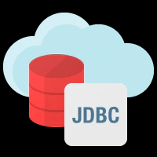
Spring Boot JDBC
Spring Boot provides a library to connect to our app with JDBC.
The following are the steps to create and setup JDBC with Spring Boot.
1. Configure the connection database for both the username and password in the Application.properties file.
2. Create Controller, Service and DAO for query CRUD

Slide 39
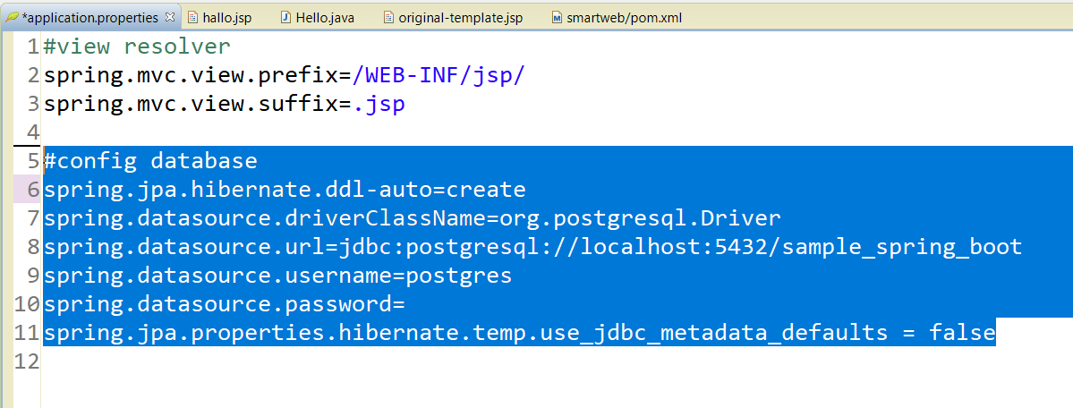
Working with Database
Create Database in Postgresql “Sample_Spring_Boot”
Configure file application.properties to postgresql Driver

Slide 40
ORM
ORM (Object Relational Mapping) is a programming technique for converting data between relational databases to OOP such as java, C, and others.
For training this time automatically using ORM: Hibernate.

Slide 41
Spring Boot JPA
JPA is a framework in java programming using the Object Relational Maping (ORM) approach to manage relational data.
Spring Boot provides a spring-boot-starter-data-jpa starter to efficiently connect Spring applications with relational databases.
Spring Data JPA is a library / framework that added the JPA repository abstraction layer.

Slide 42
Spring Data JPA
Create and support repositories.
Support JPA Query
Support batch loading, sorting dan dynamical query
Support “Mapping for entities”
Reduce general CRUD operations scripts using CrudRepository or JpaRepository
The Repository configuration uses java config with @EnableJpaRepositories.

Slide 43
Data Model
Domain model instances often need to be persisted in a database, and in Java, they typically conform to the Java Beans specification.
For example, in a shop application, some of your domain model classes would be Product, Order, ShoppingCart and Customer.

Slide 44
Create Model
Create Model Package
Create Data Model Class
give annotations to the model class

Slide 45
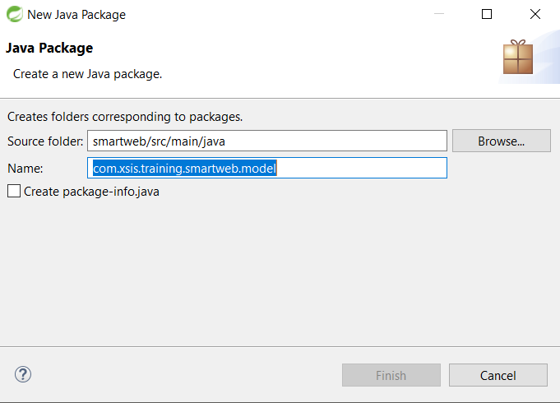
Create Model Package

Slide 46
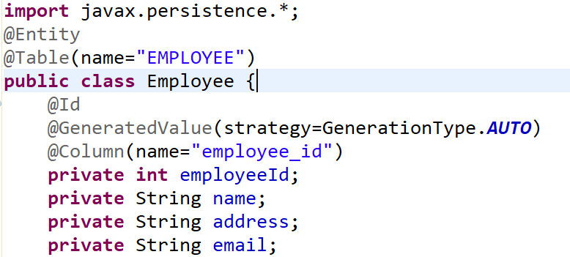
Create Employee Data Model
Don’t forget Getter and Setter

Slide 47
Spring Data Repository
Is a data abstraction for the implementation of data access in the database.
facilitate in communication with the database, especially when standard features are provided in ready-to-use activities.
Super classes that are commonly used are JpaRepository.

Slide 48
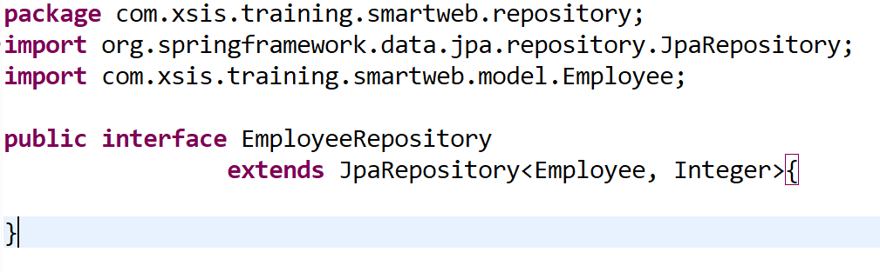
Create Repository
Create Package Repsitory
Create Class Extends JpaRespository

Slide 49
Service Layer
Service layers are commonly used for the implementation of a logic application business.
As a template for calling DAO or Spring Repository.
Makes it easy for maintenance and development because it can separate between front end and backend applications.

Slide 50
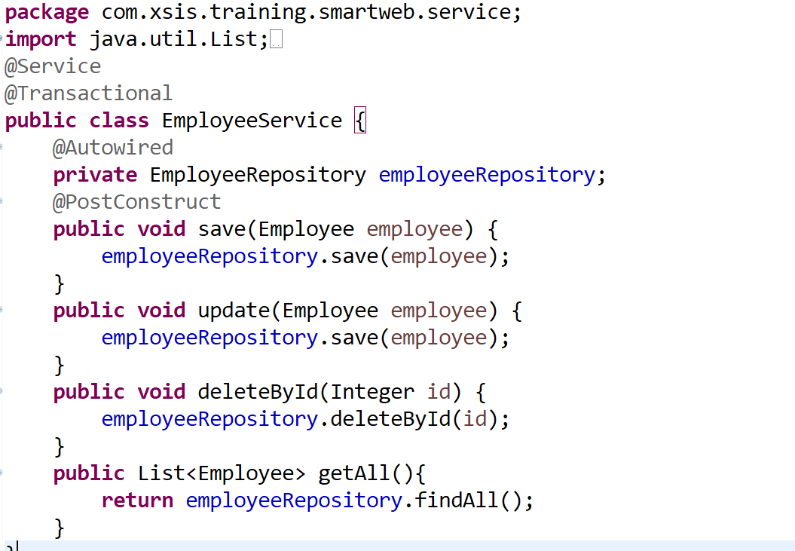
Create Service Layer
Create Repository Directory
Create EmployeeService Class

Slide 51
Transaction
A database transaction is a sequence of actions that are treated as a single unit of work
Atomicity − A transaction should be treated as a single unit of operation, which means either the entire sequence of operations is successful or unsuccessful.
Consistency − This represents the consistency of the referential integrity of the database, unique primary keys in tables, etc.
Isolation − There may be many transaction processing with the same data set at the same time. Each transaction should be isolated from others to prevent data corruption.
Durability − Once a transaction has completed, the results of this transaction have to be made permanent and cannot be erased from the database due to system failure.

Slide 52
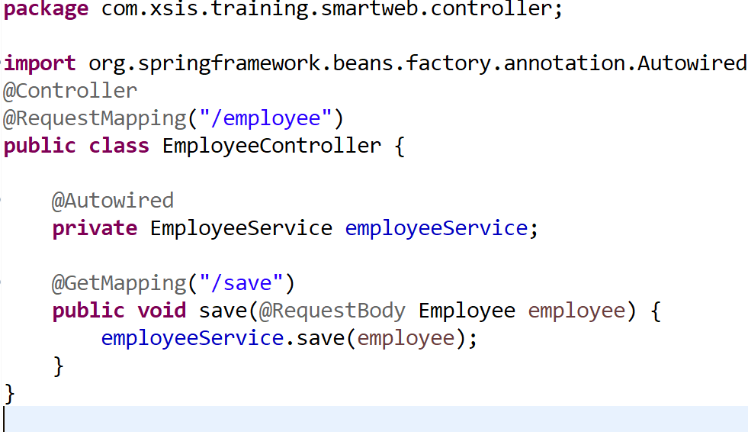
Saving Data

Slide 53
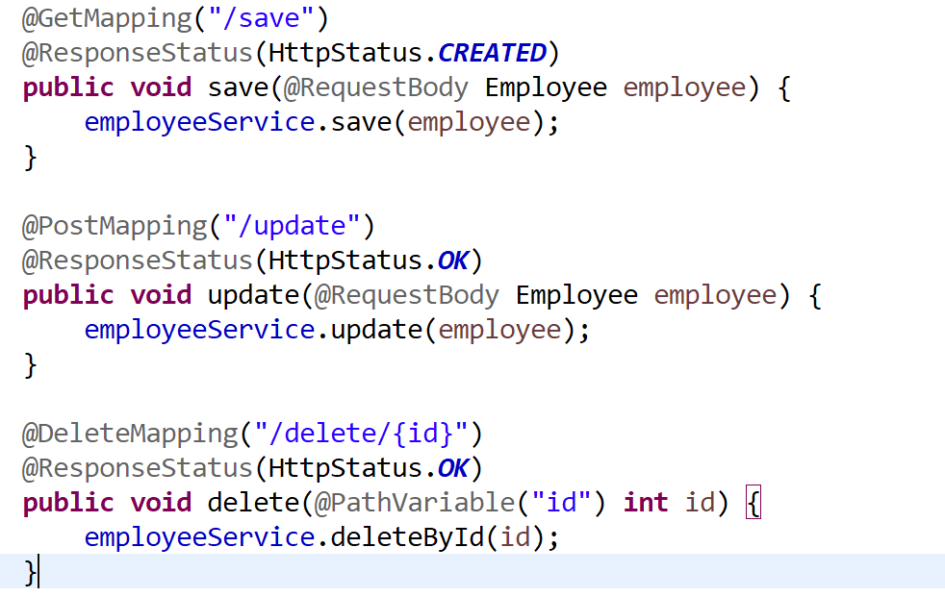
Sample CRUD

Slide 54
Employee CRUD
Create CRUD Employee Table
Save data Form
Add Form Validation
Show Data to HTML Table
Update Data
Delete Data
Populate Data with Datatables
Working with Ajax

Slide 55
Spring Framework
Day 6, 7
Operation CRUD
Data Model
Create Form
Form Validation

Slide 56
Save Data Form
Create Data Model
Create EmployeeController as Controller
Create Form as View and Add Form Validation
Create Repository
Create Service

Slide 57
Create Data Model
Create Package Model.
Create Class Employee Model to define Object data Employee to database.
Object Database will generated by Hibernate ORM
Give Hibernate Annotation and Validator.
Data Model often map roughly to the records of a corresponding database table

Slide 58
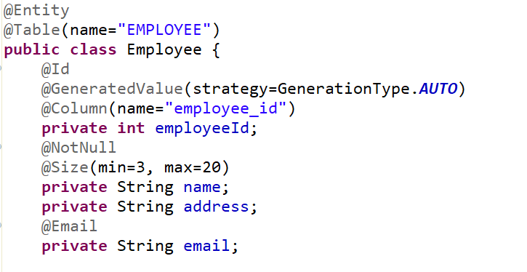
Create Data Model (Code)
*> @Entity, EJB 3 standard annotations are contained in the java persistence package
*> @Table annotation allows you to specify the details of the table that will be used to persist the entity in the database
*> @Id mean a primary key, which you annotate on the class
*> @Column annotation is used to specify the details of the column to which a field or property will be mapped
*> @GeneratedValue is Annotation to generate code id incrementally, like autoicrement or serial
*> @NotNull, is annotation of validator for data can not be empty
*> @Size, is a validator for sizing inputting data of characters
*> @Email, is annotation of validator, requires that the data that is filled in is in the form of e-mail

Slide 59
Create Employee Controller
Create Package Controller
Create Class EmployeeController
Define Request Method of Controller to Handle Request Header
Create Routing URL with @RequestMapping

Slide 60
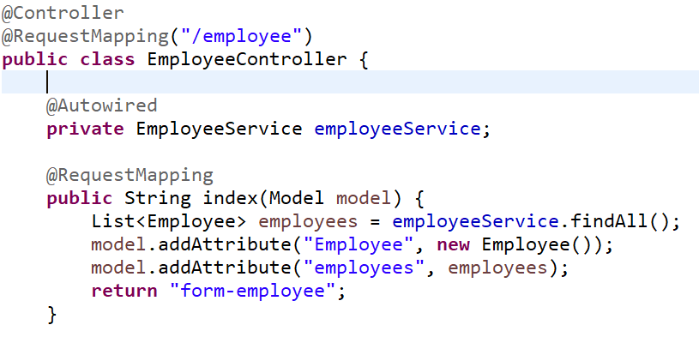
Create Employee Controller (Code)
Create EmployeeController in Package Controler (filename : EmployeeController.java)
*> @Controller annotation indicates that a particular class serves the role of a controller
*> @RequestMapping annotation that specify what HTTP Request is handled by the controller and by its method.
*> @ModelAttribute refers to a property of the Model object
*> Model parameter can supply attributes used for rendering views.
*> @PostMapping refers to Method POST Request Header

Slide 61
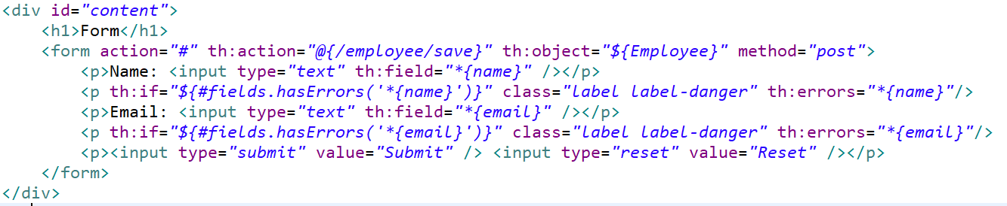
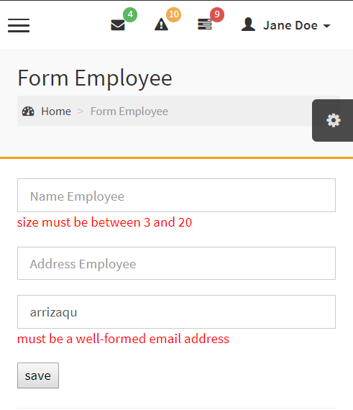
Create Form as View and Add Form Validation
Create file : form-employee.html as view
@{…} shows the application root
th:object refers to object data model
*{….} mean shows fields of defined objects
${#fields.hasErrors to display error messages in each field

Slide 62
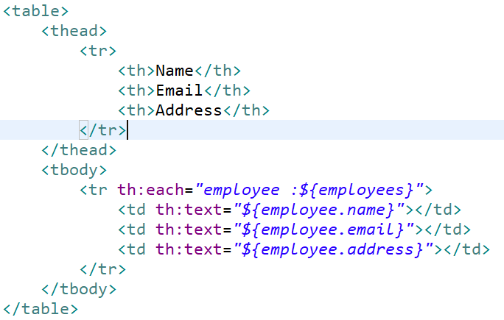
Show Datatable html
${…} shows the Object or file data Model
th:each mean “for each” element in the result of evaluating list ${object}

Slide 63
Create Repository
Create Package Repository
Create Class EmployeeRepository
Generically refers to a central place where data is stored and maintained
A repository can be a place where multiple databasesor files are located for distribution over a network
* *

Slide 64
Create Repository (code)

Slide 65
Service Layer
Service layers are commonly used for the implementation of a logic application business.
As a template for calling DAO or Spring Repository.
Makes it easy for maintenance and development because it can separate between front end and backend applications.

Slide 66
Create Implementation of Service
Create Service Package
Create Service Class
Autowired Spring Repository if want communicate with database.

Slide 67
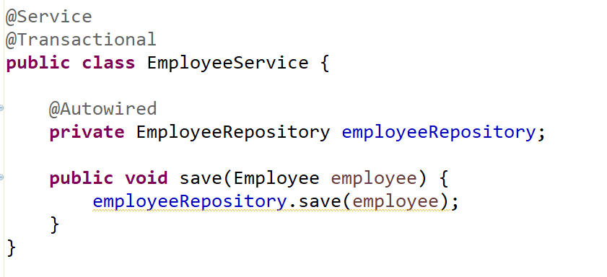
Create Implementation of Service (Code)
*> @Service beans hold the business logic and call methods in the repository layer.
*> @Autowired annotation to auto wire bean on the setter method, constructor or a field.
*> @Transactional Annotation will needs to be explicitly written so as to commit when everything is successful and rolling back if anything goes wrong.
The transaction management code is tightly bound to the business logic.

Slide 68
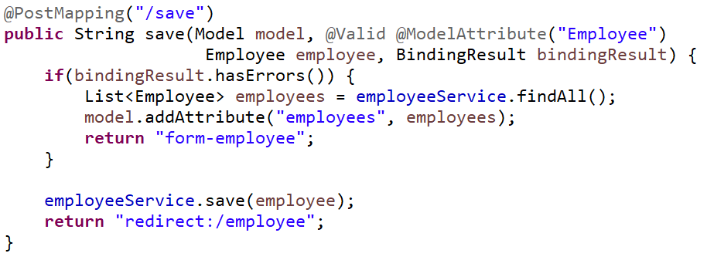
Add Save Method
Add Method Save at EmployeeController class
*> @Valid will ensure that Form Validation is active.

Slide 69
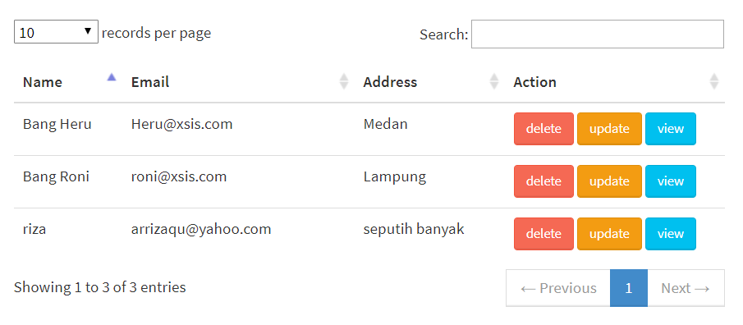
Show Data to HTML Table
Add Method get Data Employee in EmployeeService.
Modify Index method in EmployeeController
Create Table and Foreach Data List Object in view HTML table

Slide 70
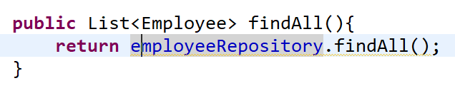
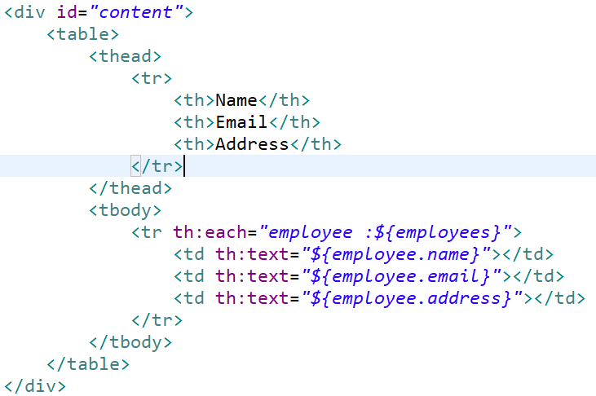
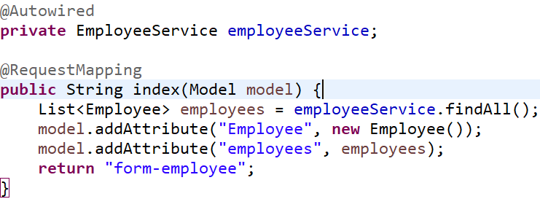
Show Data to HTML Table (Code)
EmployeeService class as Service
HTML (Thymeleaf) as View
EmployeeController Class as Controller

Slide 71
Update Data
Create Modal from Bootstrap
Create method getting data by id
Create Update method in Controller to handle Request
Create Update method in Service
must know about Bootstrap
must know about javascript
must know about jquery
must know about Ajax

Slide 72
Boostrap Ui Framework
Bootstrap is an open source toolkit for developing with HTML, CSS, and JS
some very useful features from User Interface are tables, responsive media queries, grid systems, Modal, UI templates, datatable, and others.
supports javascript libraries with jquery, such as Modal, Events and tooltips.
one of the bootstrap templates that is often used is adminlte, see more https://adminlte.io/
See Bootstrap more at https://getbootstrap.com/

Slide 73
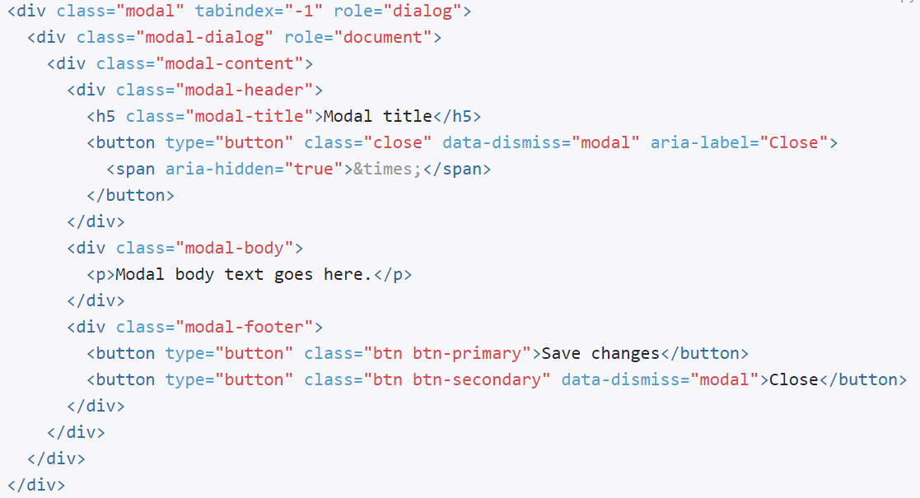
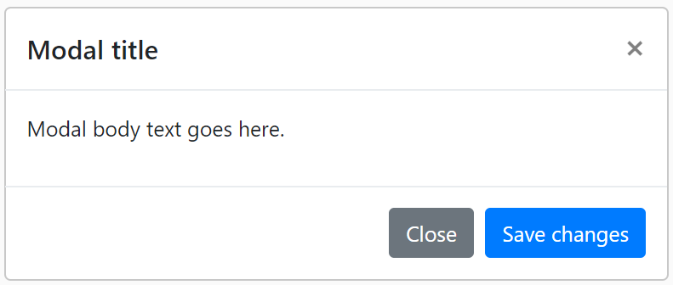
Modal Bootstrap
Modal plugin to add dialogs to your site for lightboxes, user notifications, or completely custom content

Slide 74
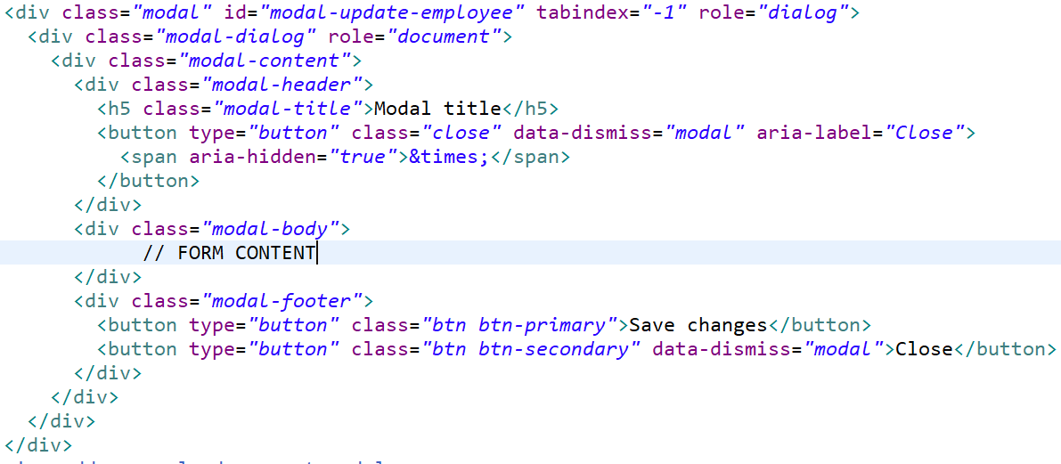
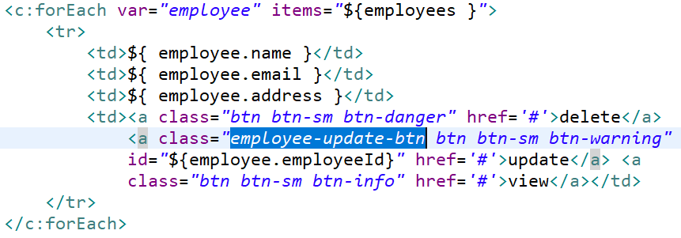
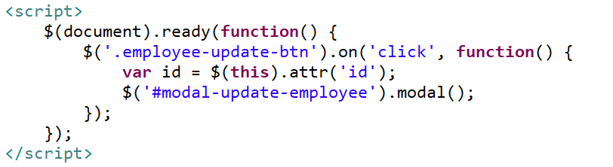
Create Modal From Bootstrap 1
Add tag Modal div to html
Add class Employee-update-btn
Call Modal Id with javascript

Slide 75
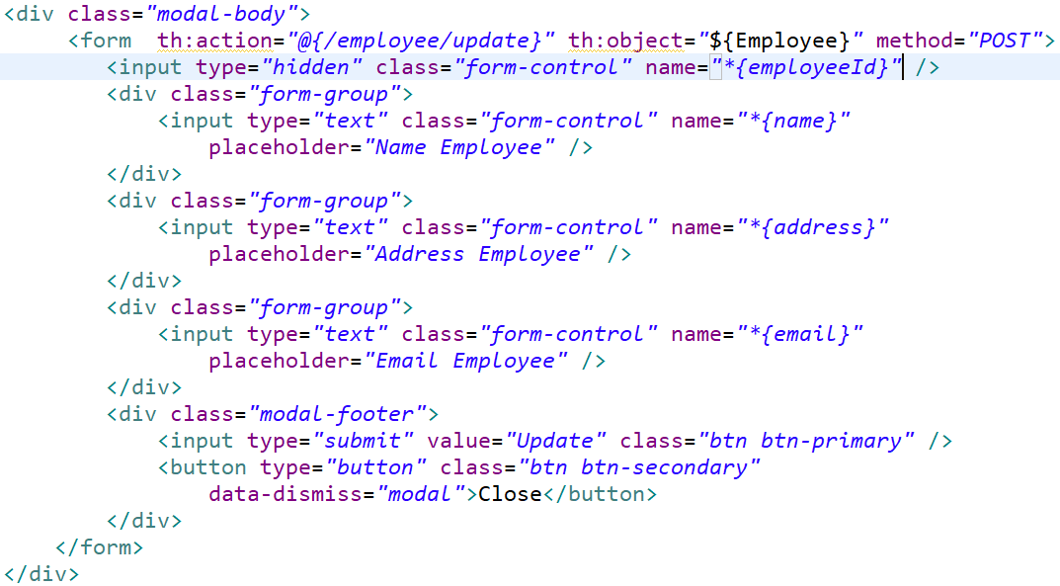
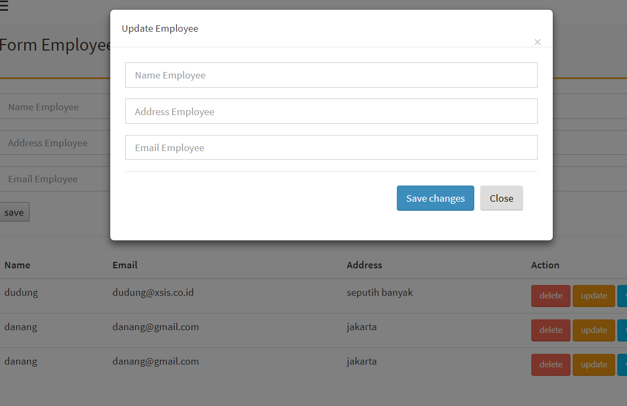
Create Modal From Bootstrap 2
Modify Class “modal-body” to Form Content

Slide 76
Ajax (Asyncronous Javascript and XML)
AJAX = Asynchronous JavaScript And XML.
AJAX just uses a combination of:
* A browser built-in XMLHttpRequest object (to request data from a web server)
* JavaScript and HTML DOM (to display or use the data)
AJAX allows web pages to be updated asynchronously by exchanging data with a web server behind the scenes.
possible to update parts of a web page, without reloading the whole page

Slide 77
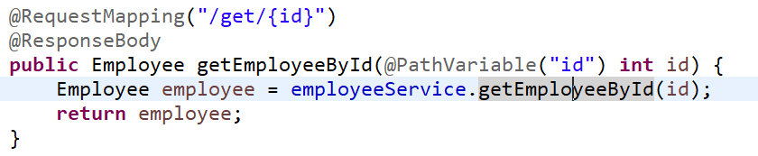
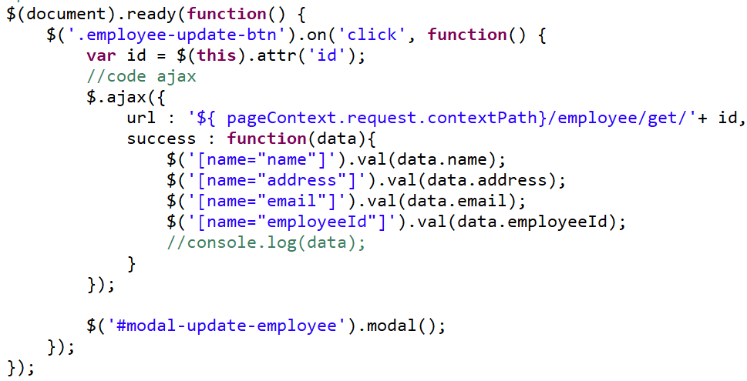
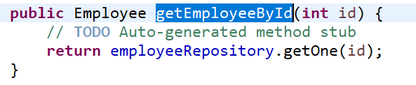
Create method getting data by id
Create method getting data by id in EmployeeController
Create Request with Ajax
Create method getting data by id in EmployeeService

Slide 78
Why Use Ajax ?
Update a web page without reloading the page
Request data from a server - after the page has loaded
Receive data from a server - after the page has loaded
Send data to a server - in the background

Slide 79
Javascript Output
Writing into an HTML element, using innerHTML.
Writing into the HTML output using document.write().
Writing into an alert box, using window.alert().
Writing into the browser console, using console.log().

Slide 80
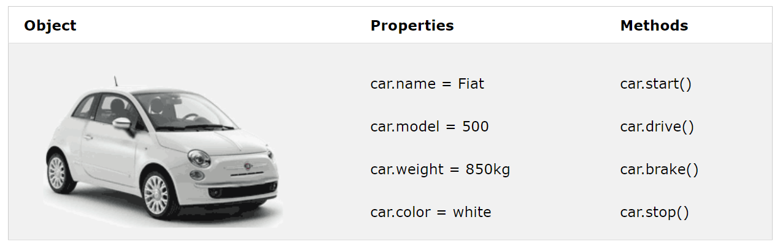
Javascript Object

Slide 81
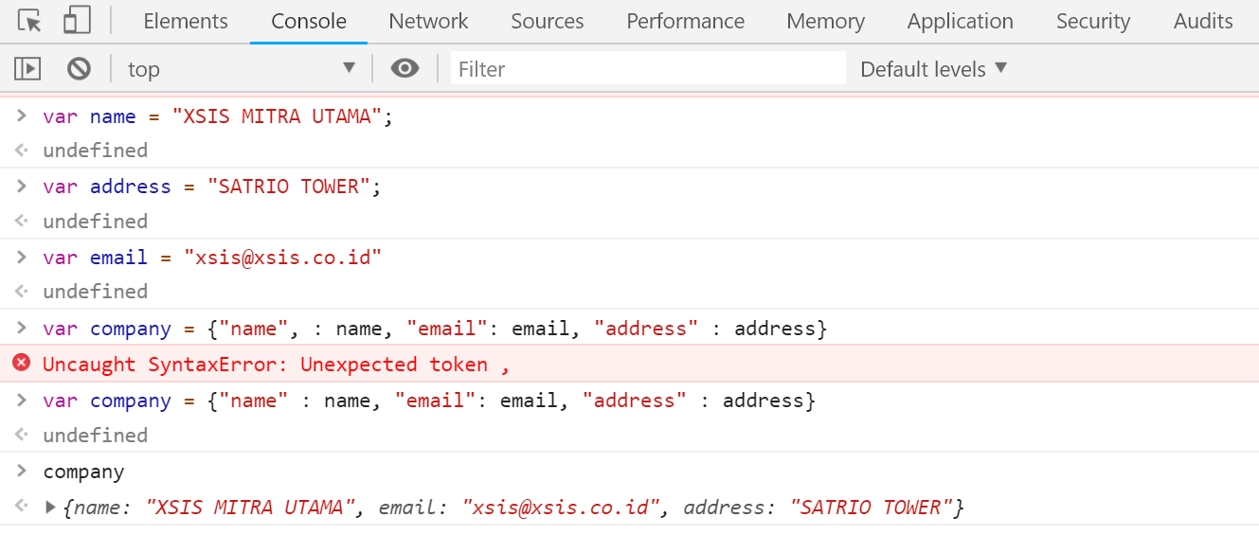
Browser Console

Slide 82
Create POS Project
Tables: 1. Category, 2. Variant, Product, 3. Order, 4. OrderDetail
Create Relation POS table
Create CRUD

Slide 83
Day 8 - 10
Task & Case of POS

Slide 84
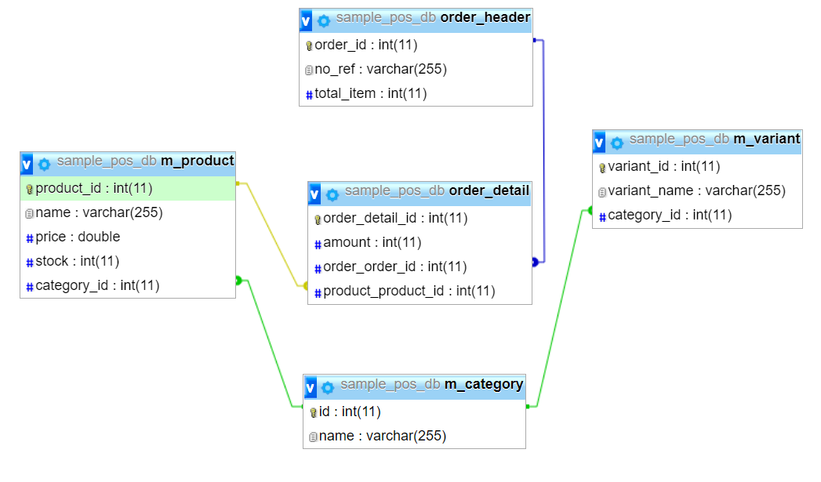
Create Relation POS tables ERD

Slide 85
Master
Category
Variant
Product

Slide 86
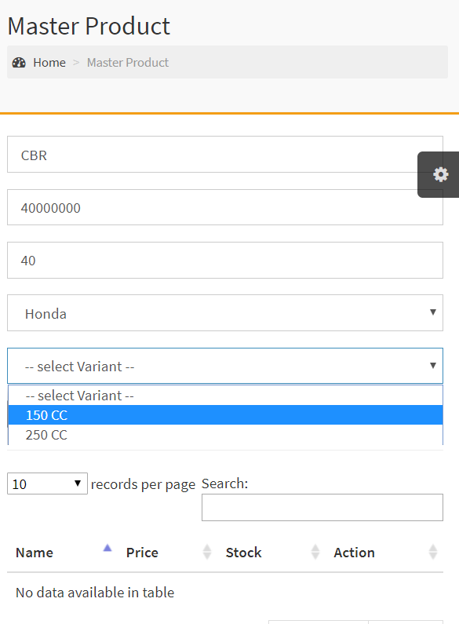
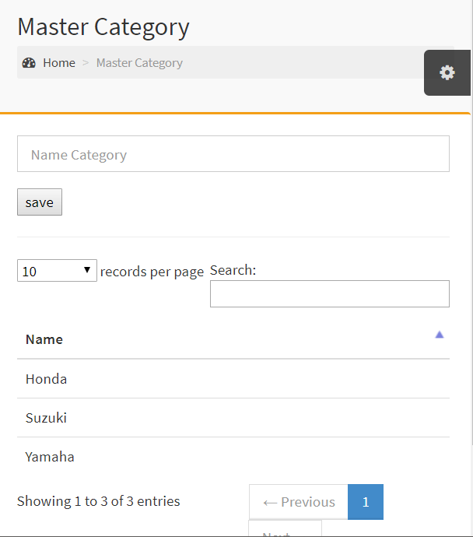

User Interface
CRUD Product
CRUD Category
CRUD Category

Slide 87

Thank You

